Slide 1
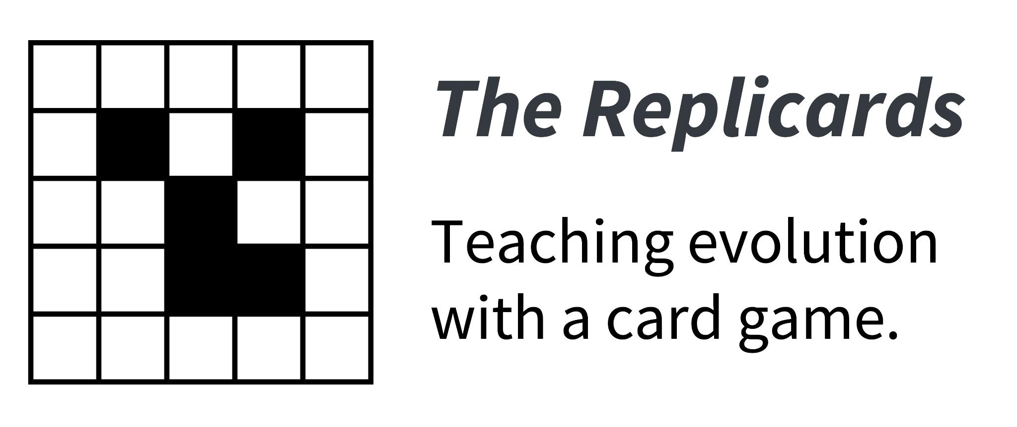
Teaching evolution with a card-based experiment
Elia Mascolo & Yseult Héjja-Brichard
Teacher slides
Notes:
Slides suggestion to present after the Replicards activity to contextualize and connect with biology the concepts “discovered” by the students during the activity.

Slide 2
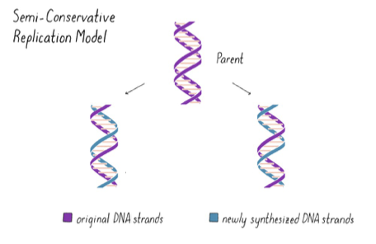
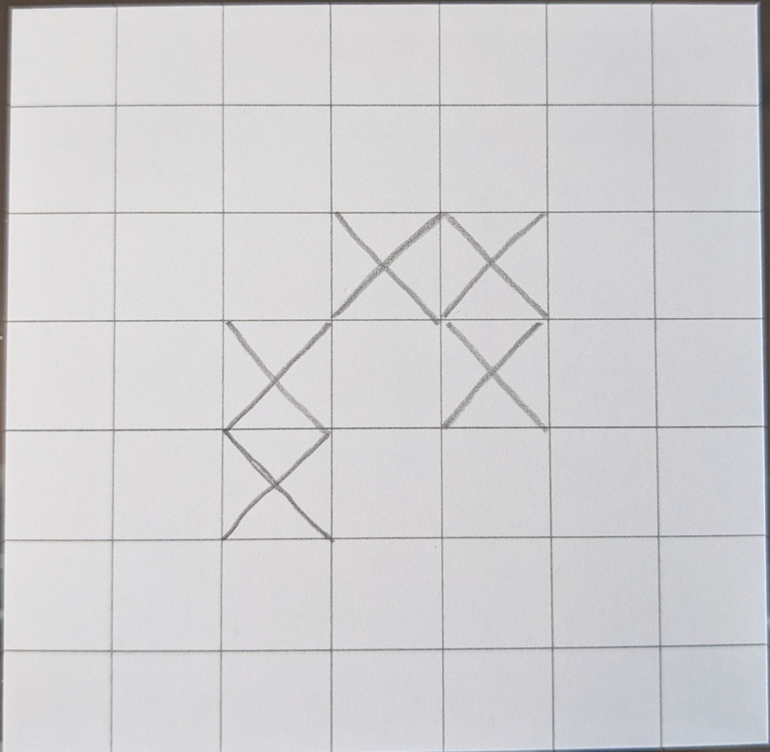
Replication
Notes:
Introducing DNA

Slide 3
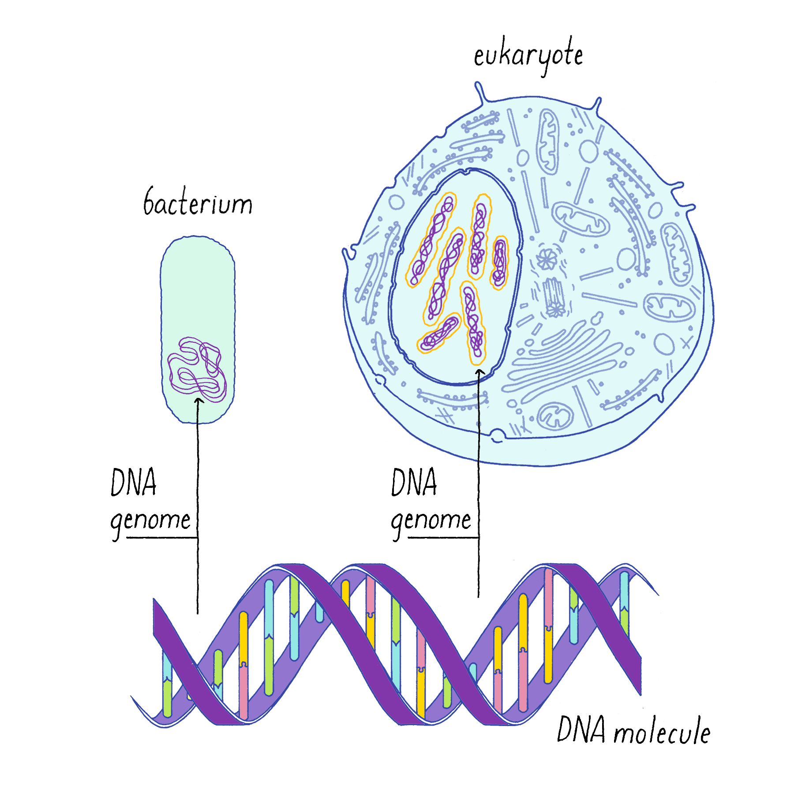
Replication
→ Where is DNA located?
Notes:
Source: https://explorebiology.org/collections/all/how-dna-replicates

Slide 4
Replication
→ What happens with DNA?
Notes:
Source: https://explorebiology.org/collections/all/how-dna-replicates

Slide 5
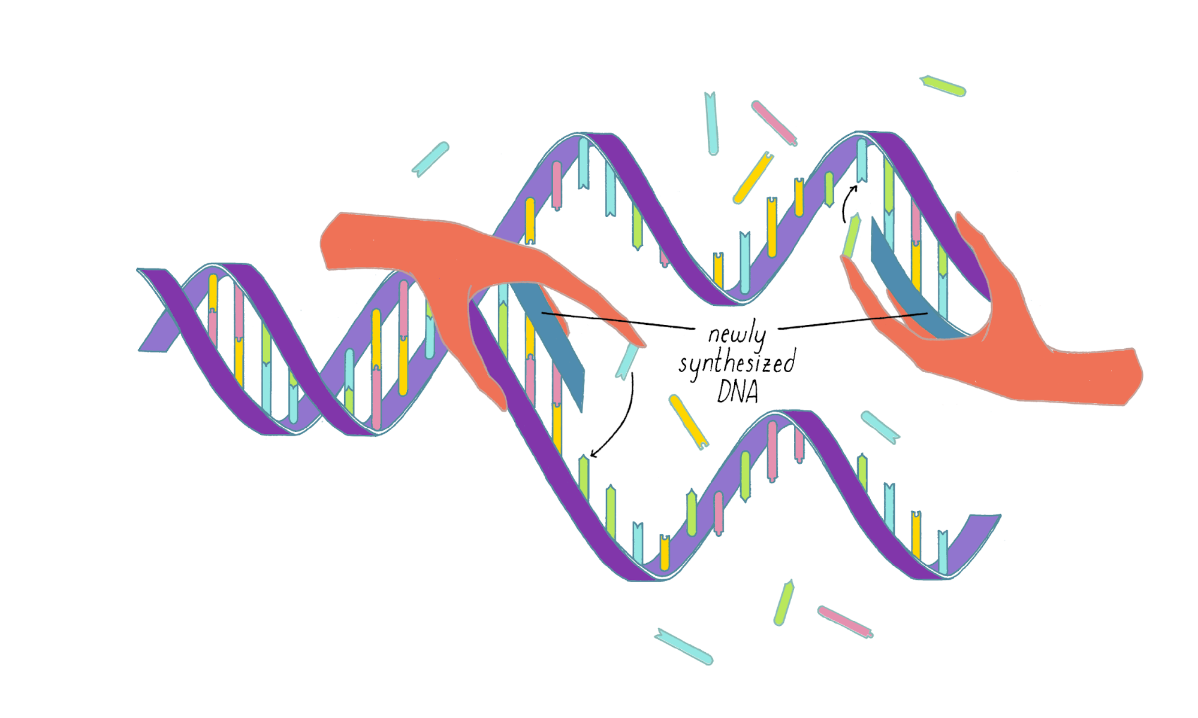
Replication
→ How?
A (adenine)
T (thymine)
C (cytosine)
G (guanine)
Notes:
Double helix allows for creation of two copies each inheriting one strand (purple strands). The other strand is re-synthetized based on complementary base pairing (blue strands).
Source: https://explorebiology.org/collections/all/how-dna-replicates

Slide 6
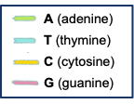
Replication
→ How?
ATTAGCAGTACC
TAATCGTCATGG
ATTAGCAGTACC
TAATCGTCATGG
ATTAGCAGTACC
TAATCGTCATGG
Notes:
Alternative representation

Slide 7

Reproduction

Slide 8
Mutation
ATTAGCAGTACC
TAATCGTCATGG
ATTAGTAGTACC
TAATCATCATGG
ATTAGCAGTACC
TAATCGTCATGG

Slide 9
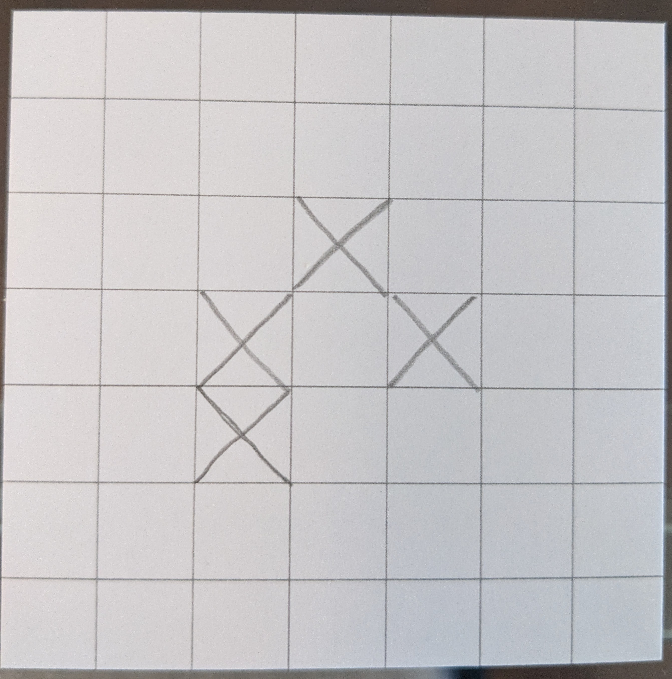

Mutation

Slide 10
Heredity
Replication with mutation
The mutation is inherited

Slide 11
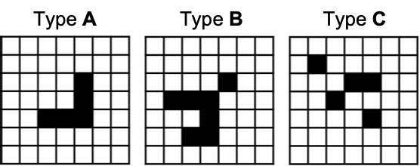
Fitness
Fitness measures reproductive success

Slide 12
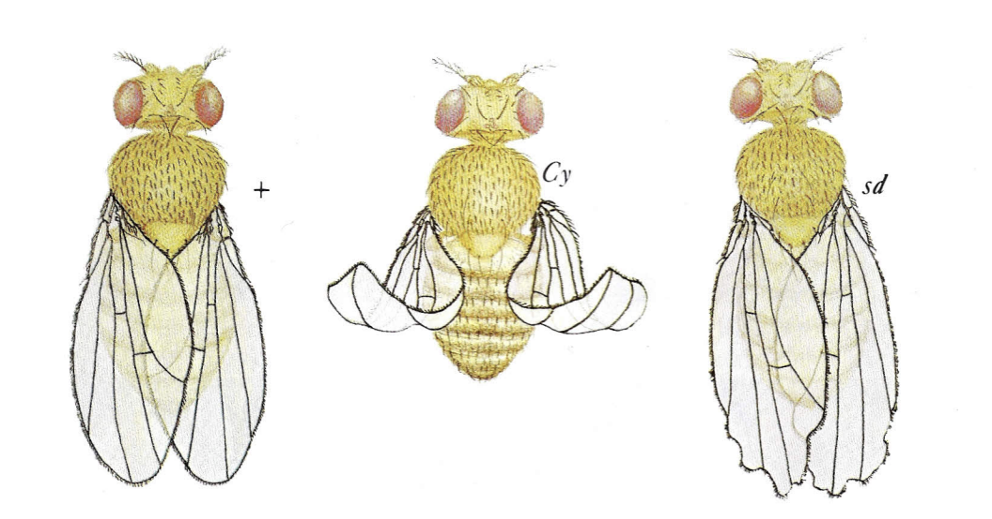
Fitness
Fitness
Notes:
Source drosophila flies: https://sites.rochester.edu/larracuente//wp-content/uploads/2016/01/CarolinaDrosophilaManual0001.pdf

Slide 13
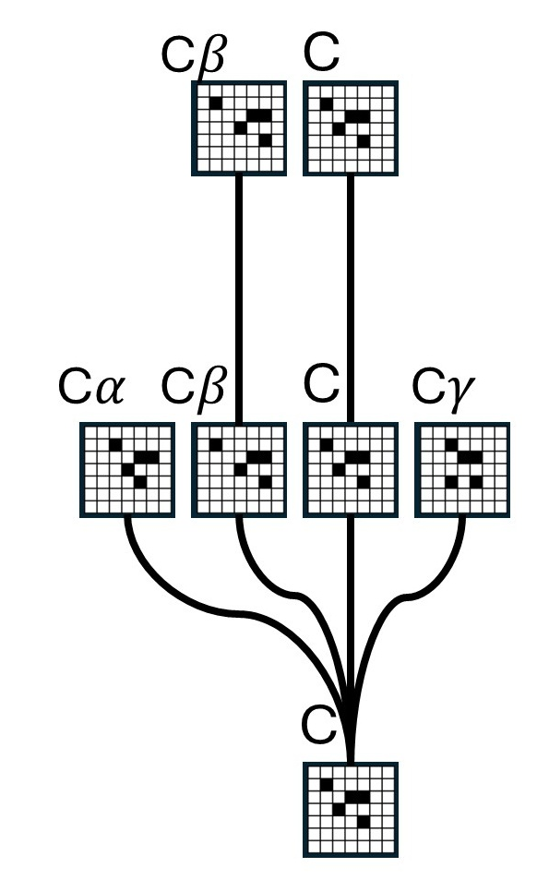
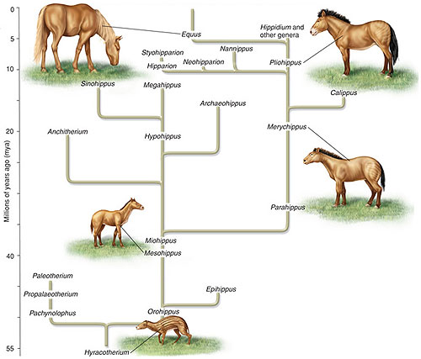
Phylogeny
Notes:
Source horses: https://calaski.wordpress.com/wp-content/uploads/2012/10/horse-evolution-tree.jpg

Slide 14
What is evolution?
From Wikipedia:
Evolution is the change in the heritable characteristics of biological populations over successive generations.
Some words are important:
change: the frequency of a character can change (even from 0 to a positive value, i.e., a «new» character appears)
heritable: not all characters are inheritable! But mutations are.
populations: populations evolve (not the individuals)

Slide 15
Appendix – Protocol summary

Slide 16

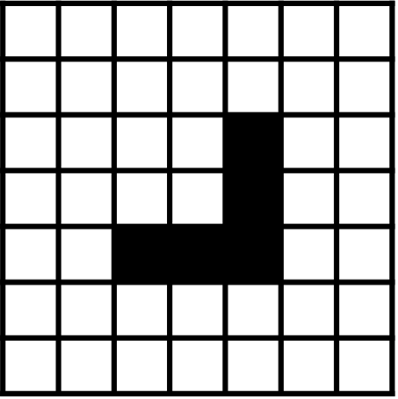



Protocol
10 seconds
TEMPLATE VISIBLE
1) Memorization Phase (10 seconds)
CARD FACE DOWN
CARD FACE DOWN
REPLICAS
TEMPLATE
2) Replication Phase (30 seconds)
CARD FACE DOWN
ALL REPLICAS
3) Competition Phase
ONE CARD PER STUDENT
(NEXT GENERATION TEMPLATES)

